Slide 1

Game Theory Eleven
BNN Error Orders
Navier Stokes to Mean Field Games
Jacob Wyngaard

Slide 2
Convergence of RK 4 Solution to Actual Solution
Two players each with two strategies, neither with a strictly dominant strategy
Player 1 Payoff Matrix
Player 2 Payoff Matrix
Player 2
Player 2
A
B
A
B
1
2 | 3
4 | 1
1
7 | 5
6 | 8
Player 1
Player 1
2
2
Player 1 Strategy:${ p}^{1}=(x^{1},y^{1})$ Player 2 Strategy:${ p}^{2}=(x^{2},y^{2})$

Slide 3
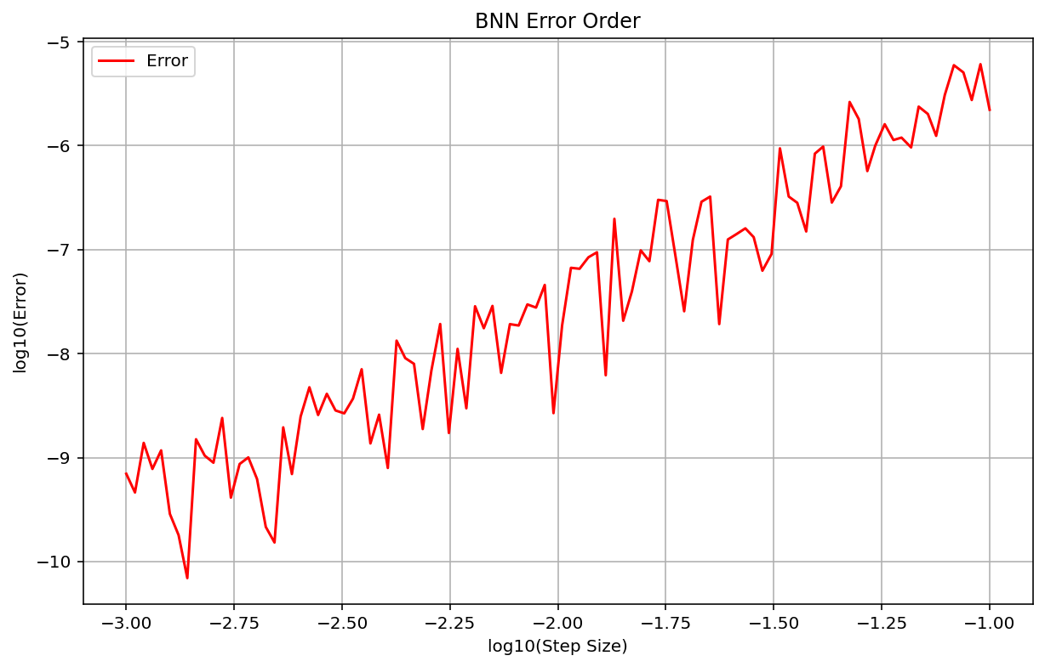
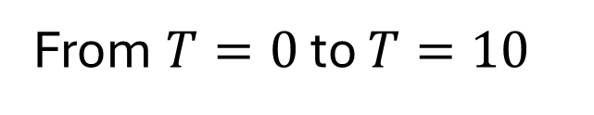
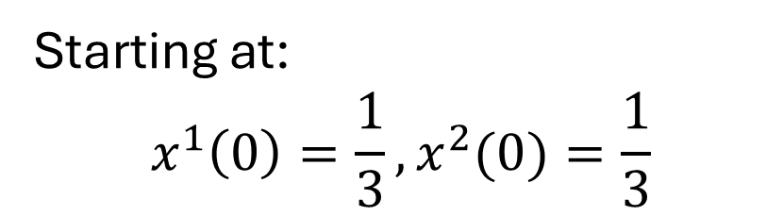
Convergence of RK 4 Solution to Actual Solution [Last Time]
Starting at:
$$x^{1}\left(0\right)=\frac{1}{3},x^{2}(0)=\frac{1}{3}$$
From $T=0$ to $T=10$
“Actual Solution” Solved Using Adaptive Runge Kutta

Slide 4
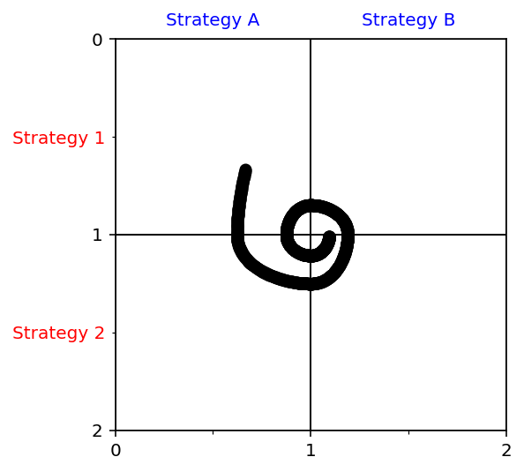
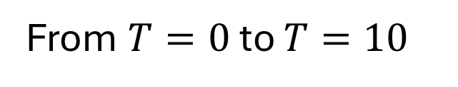
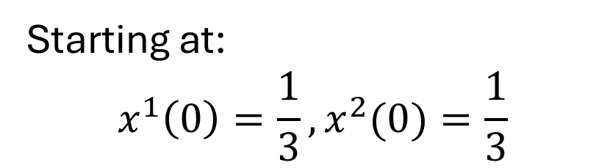

Convergence of RK 4 Solution to Actual Solution
Starting at:
$$x^{1}\left(0\right)=\frac{1}{3},x^{2}(0)=\frac{1}{3}$$
From $T=0$ to $T=10$
$$h=.01$$

Slide 5


Convergence of RK 4 Solution to Actual Solution
$$h=.01$$
$$h=.0001$$
Same pattern regardless of step size

Slide 6
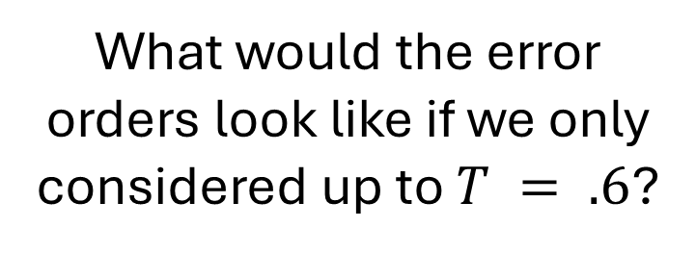
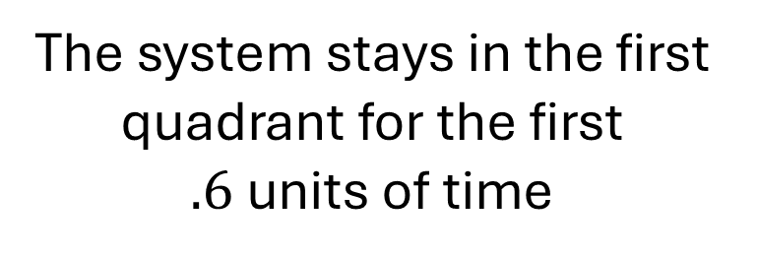
Convergence of RK 4 Solution to Actual Solution
The system stays in the first quadrant for the first $.6$units of time
What would the error orders look like if we only considered up to $T = .6$?

Slide 7
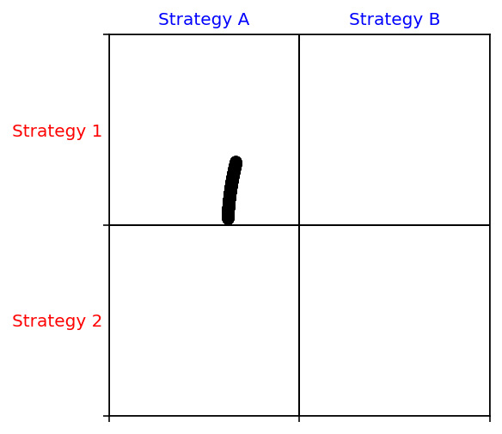
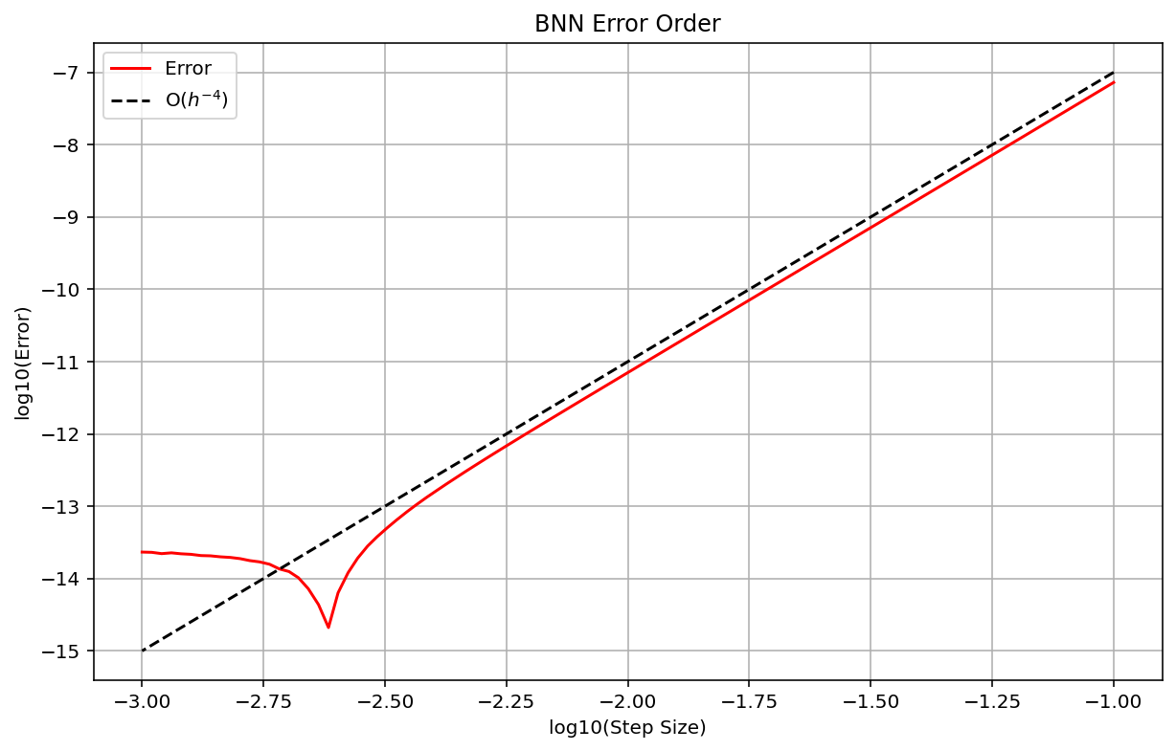
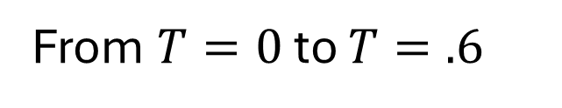
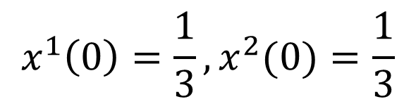
Convergence of RK 4 Solution to Actual Solution
$$x^{1}\left(0\right)=\frac{1}{3},x^{2}(0)=\frac{1}{3}$$
Consistent Jacobian ensures proper error order
From $T=0$ to $T=.6$

Slide 8
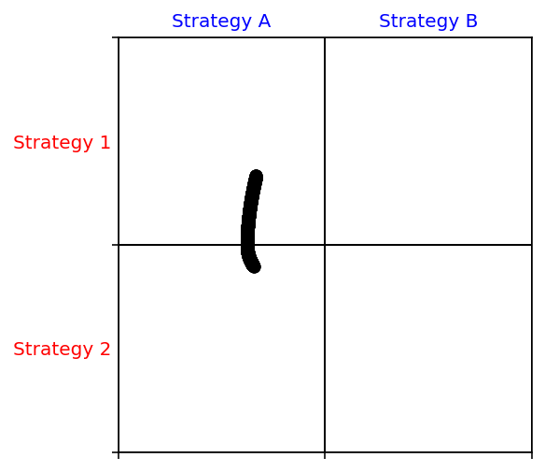
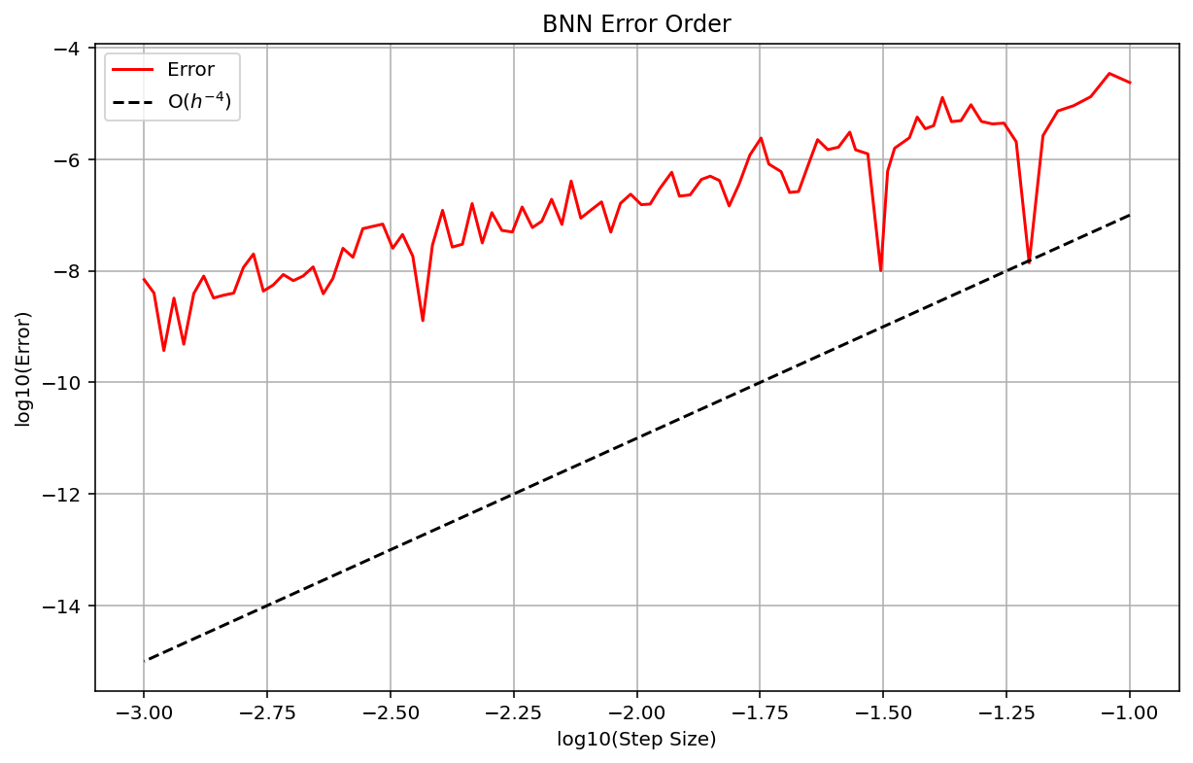
Convergence of RK 4 Solution to Actual Solution
$$x^{1}\left(0\right)=\frac{1}{3},x^{2}(0)=\frac{1}{3}$$
Inconsistent Jacobian interferes with error order
From $T=0$ to $T=.6$

Slide 9
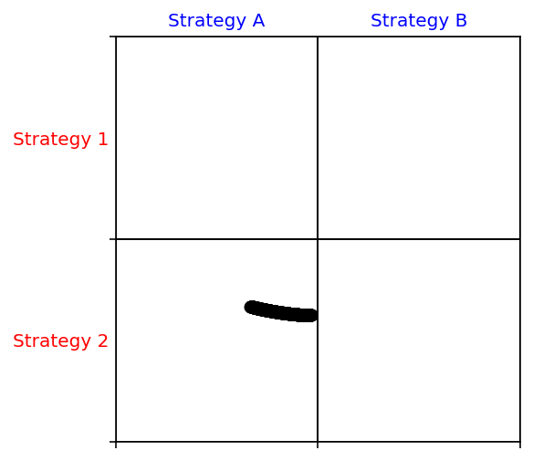

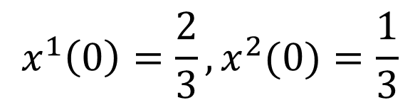
Convergence of RK 4 Solution to Actual Solution
$$x^{1}\left(0\right)=\frac{2}{3},x^{2}(0)=\frac{1}{3}$$
Consistent Jacobian ensures proper error order
From $T=0$ to $T=.6$

Slide 10
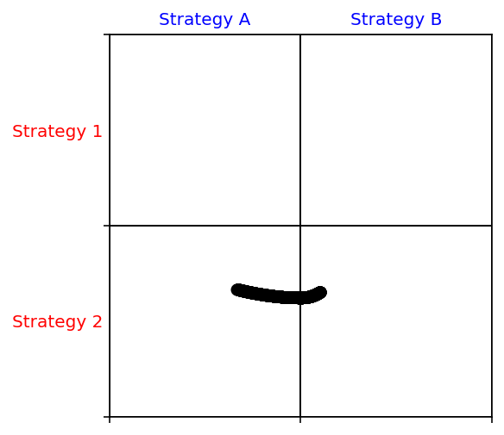

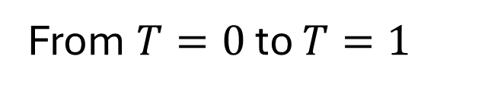
Convergence of RK 4 Solution to Actual Solution
$$x^{1}\left(0\right)=\frac{2}{3},x^{2}(0)=\frac{1}{3}$$
Inconsistent Jacobian interferes with error order
From $T=0$ to $T=1$

Slide 11
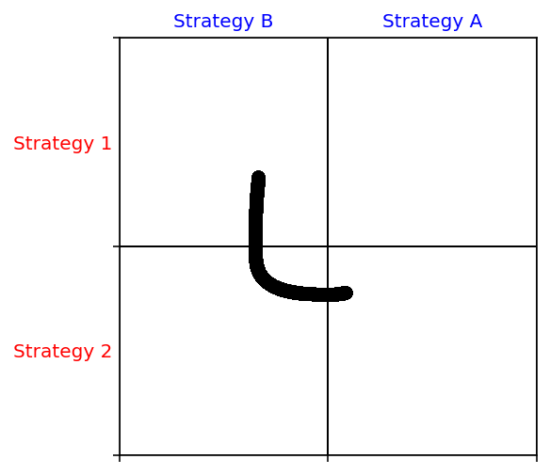
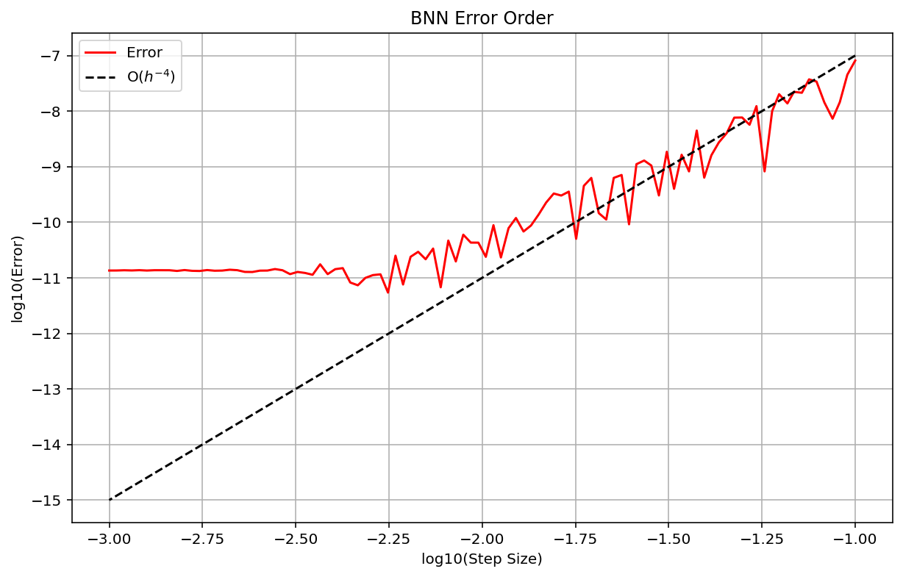
Rectified Quadratic Unit
$$x^{1}\left(0\right)=\frac{2}{3},x^{2}(0)=\frac{1}{3}$$
$$φ_{ij}\left(p\right)={max⁡(0, {Payoff}_{i}\left(e_{j}\right)−{Payoff}_{i}\left(p\right))}^{2}$$
From $T=0$ to $T=1$

Slide 12


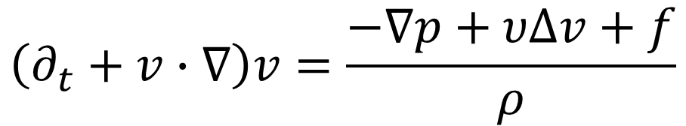

Compressible Navier-Stokes
$$\left(∂_{t}+v∙∇\right)v=\frac{−∇p+υΔv+f}{ρ}$$
Flow
$$v\left(0,x\right)=v_{0}\left(x\right)$$
$$∂_{t}ρ+∇∙(ρv)=0$$
Density
$$ρ(0,x)=ρ_{0}(x)$$

Slide 13

Numerically Modeling Compressible Navier-Stokes
Currently, I am numerically modeling Navier-Stokes using second order finite difference methods for the derivatives and forward Euler for time evolutions
To increase the speed of numerical computation, I used JAX to turn the step updates into optimized machine code (XLA – Accelerated Linear Algebra)

Slide 14
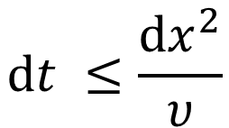

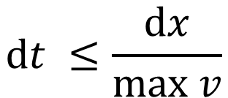

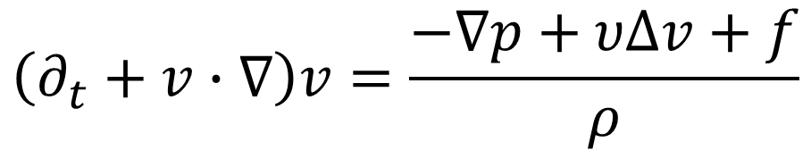

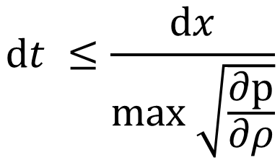
Numerical Stability of Modeling Compressible Navier-Stokes
$$\left(∂_{t}+v∙∇\right)v=\frac{−∇p+υΔv+f}{ρ}$$
Convective Condition
$$dt ≤\frac{dx}{max v}$$
Flow
$$v\left(0,x\right)=v_{0}\left(x\right)$$
Diffusive Condition
$$∂_{t}ρ+∇∙(ρv)=0$$
$$dt ≤\frac{{dx}^{2}}{υ}$$
Density
$$ρ(0,x)=ρ_{0}(x)$$
Compressibility Condition
$$dt ≤\frac{dx}{max \sqrt{\frac{∂p}{∂ρ}}}$$

Slide 15
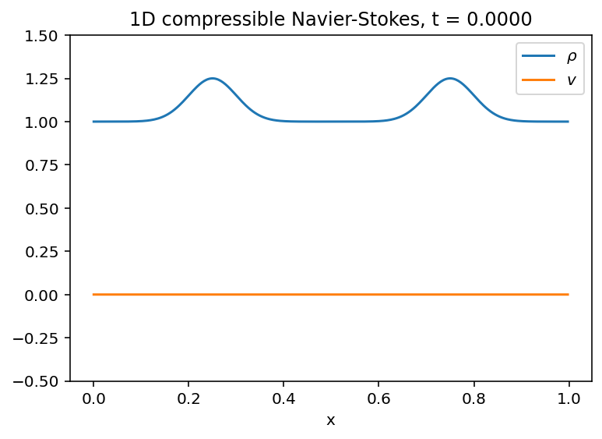
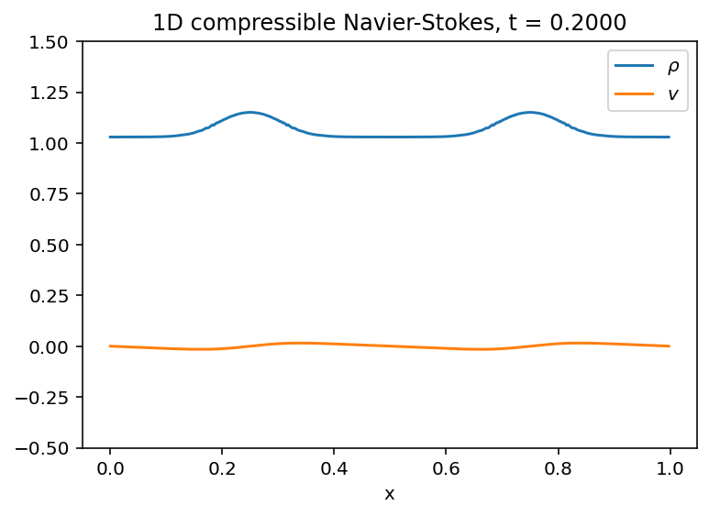
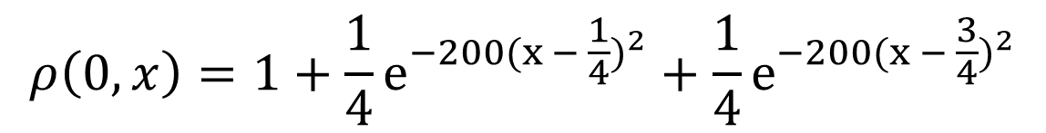
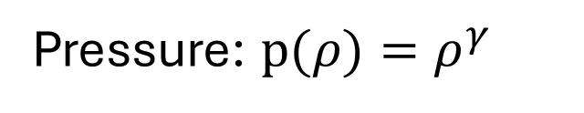

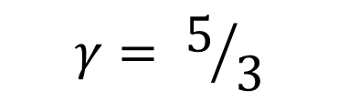
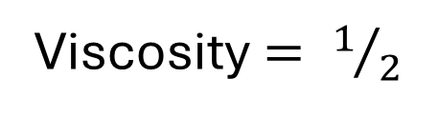
Numerically Modeling Compressible Navier-Stokes
Pressure: $p(ρ)=ρ^{γ}$
$$γ= 5/3$$
Viscosity $= 1/2$
$$ρ\left(0,x\right)=1+\frac{1}{4}e^{−200{(x − \frac{1}{4})}^{2}}+\frac{1}{4}e^{−200{(x − \frac{3}{4})}^{2}}$$
$$v\left(0,x\right)=0$$

Slide 16
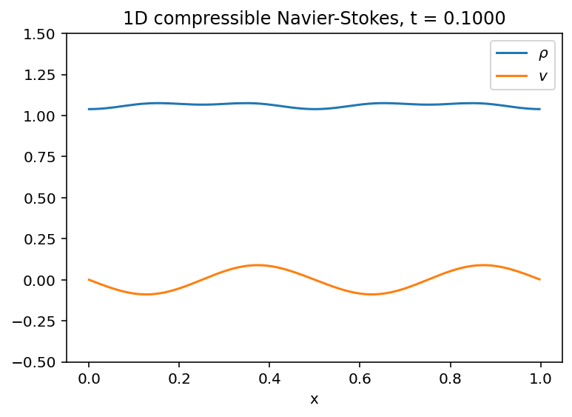
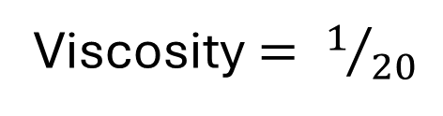
Numerically Modeling Compressible Navier-Stokes
Pressure: $p(ρ)=ρ^{γ}$
$$γ= 5/3$$
Viscosity $= 1/{20}$
$$ρ\left(0,x\right)=1+\frac{1}{4}e^{−200{(x − \frac{1}{4})}^{2}}+\frac{1}{4}e^{−200{(x − \frac{3}{4})}^{2}}$$
$$v\left(0,x\right)=0$$

Slide 17
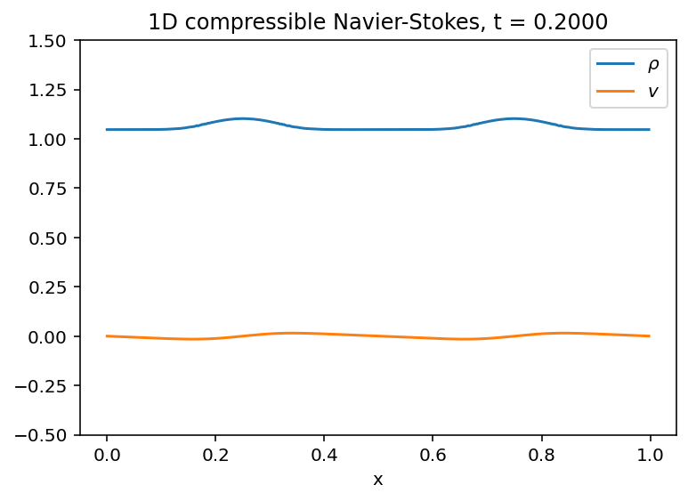

Numerically Modeling Compressible Navier-Stokes
Pressure: $p(ρ)=ρ^{γ}$
$$γ= 3$$
Viscosity $= 1/{20}$
$$ρ\left(0,x\right)=1+\frac{1}{4}e^{−200{(x − \frac{1}{4})}^{2}}+\frac{1}{4}e^{−200{(x − \frac{3}{4})}^{2}}$$
$$v\left(0,x\right)=0$$

Slide 18

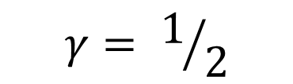
Numerically Modeling Compressible Navier-Stokes
Pressure: $p(ρ)=ρ^{γ}$
$$γ= 1/2$$
Viscosity $= 1/{20}$
$$ρ\left(0,x\right)=1+\frac{1}{4}e^{−200{(x − \frac{1}{4})}^{2}}+\frac{1}{4}e^{−200{(x − \frac{3}{4})}^{2}}$$
$$v\left(0,x\right)=0$$

Slide 19
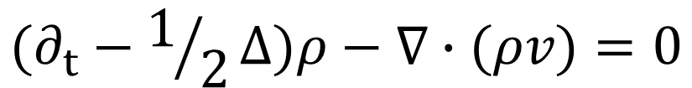

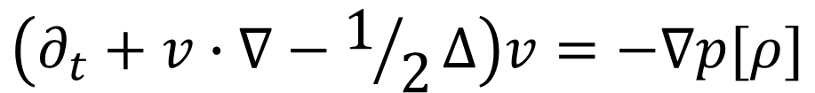

Luo and Song’s Compressible Navier-Stokes
$$\left(∂_{t}+v∙∇−1/2Δ\right)v=−∇p[ρ]$$
Flow
$$v\left(0,x\right)=∇h[ρ](x)$$
$$(∂_{t}−1/2Δ)ρ−∇∙(ρv)=0$$
Density
$$ρ(T,x)=ρ_{0}(x)$$
Note that one of Luo and Song’s changes was to add a diffusive noise term to the density evolution

Slide 20



Numerically Modeling Luo and Song’s Compressible Navier-Stokes
We have a coupled system of PDEs, one of which has an initial condition and the other which has a terminal condition
Fixed-point (Banach-Picard) iteration
Guess
$$ρ^{(0)}(t,x)$$
Repeat Until Convergence
$$\left(∂_{t}+v^{(k)}∙∇−1/2Δ\right)v^{(k)}=−∇p[ρ^{(k)}]$$
$$v^{(k)}\left(0,x\right)=∇h[ρ^{(k)}](x)$$
$$(∂_{t}−1/2Δ)ρ^{(k+1)}−∇∙(ρ^{(k+1)}v^{(k)})=0$$
$$ρ^{(k+1)}(T,x)=ρ_{0}(x)$$

Slide 21
Numerically Modeling Luo and Song’s Compressible Navier-Stokes
We have a coupled system of PDEs, one of which has an initial condition and the other which has a terminal condition
Fixed-point (Banach-Picard) iteration
Guess
$$ρ^{(0)}(t,x)$$
Repeat Until Convergence
$$\left(∂_{t}+v^{(k)}∙∇−1/2Δ\right)v^{(k)}=−∇p[ρ^{(k)}]$$
The Diffusion Term produces instability for explicit time reversal
$$v^{(k)}\left(0,x\right)=∇h[ρ^{(k)}](x)$$
$$(∂_{t}−1/2Δ)ρ^{(k+1)}−∇∙(ρ^{(k+1)}v^{(k)})=0$$
$$ρ^{(k+1)}(T,x)=ρ_{0}(x)$$

Slide 22
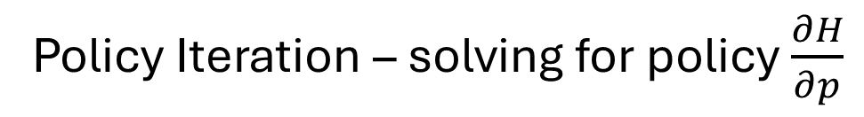
Numerically Modeling Luo and Song’s Compressible Navier-Stokes
The instability of the time-step method means that we have to look for other methods
Boundary value solving – solving for all times at the same time using a set of non-linear equations
Policy Iteration – solving for policy $\frac{∂H}{∂p}$

Slide 23
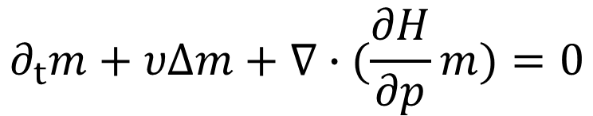







Compressible Navier-Stokes Models vs Mean Field Games
$$∂_{t}u+1/2{\left|∇u\right|}^{2}−1/2Δu=−p\left[ρ\right]$$
Compressible Navier Stokes
$$u(x,0)=h[ρ](x)$$
$$v= ∇u$$
$$∂_{t}ρ+υΔρ+∇∙(ρ∇u)=0$$
$$ρ(x,T)=ρ_{T}(x)$$
$$∂_{t}u−υΔu+H(x,∇u)=W(m)$$
Mean Field Games
$$u(x,0)=W_{0}(m(0))$$
$$∂_{t}m+υΔm+∇∙(\frac{∂H}{∂p}m)=0$$
$$m(x,T)=m_{0}(x)$$

Slide 24

Using Navier-Stokes Models to Solve Mean Field Games
We can use Navier-Stokes to model Mean Field Games when the following criteria is met:
$$H(x,∇u)=1/2{\left|∇u\right|}^{2}$$
What does this mean?

Slide 25
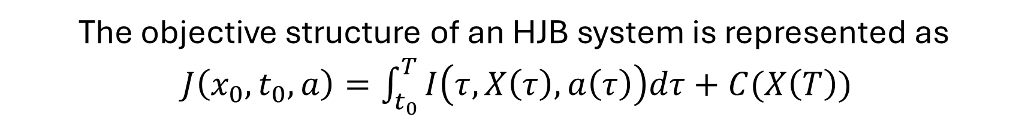

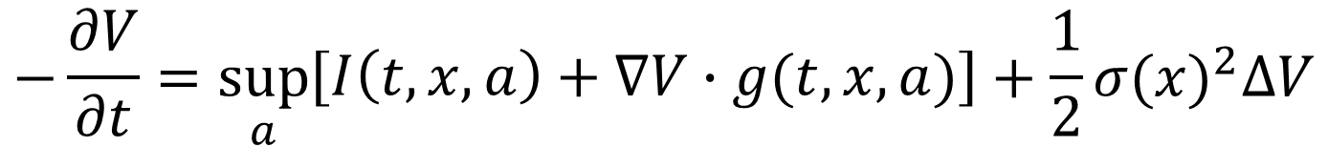
Hamiltonian Redux
The Hamiltonian encodes the best response given a cost structure
The objective structure of an HJB system is represented as
$J\left(x_{0},t_{0},a\right)=\int_{t_{0}}^{T}{I\left(τ,X\left(τ\right),a\left(τ\right)\right)dτ+C(X\left(T\right))}$
Stochastic Time Evolution: $dX(t)=g(t,X(t),a(t))dt+σ(X(t))dW(t)$
HJB Equation
$$−\frac{∂V}{∂t}=\sup_{a}\left[\begin{matrix}I\left(t,x,a\right)+∇V∙g(t,x,a)\end{matrix}\right]+\frac{1}{2}{σ(x)}^{2}∆V$$
$$\begin{matrix}\sup_{a}[I\left(t,x,a\right)+∇V∙g(t,x,a)]\end{matrix}$$
is our Hamiltonian!

Slide 26
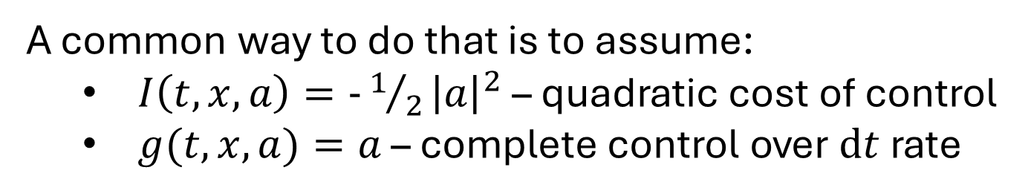
Hamiltonian Redux
For $H(x,∇u)=1/2{\left|∇u\right|}^{2}$, we need
$$\sup_{a}[I\left(t,x,a\right)+∇u∙g(t,x,a)]=1/2{\left|∇u\right|}^{2}$$
A common way to do that is to assume:
$I\left(t,x,a\right)=−1/2{\left|a\right|}^{2}$ – quadratic cost of control
$g(t,x,a)=a$ – complete control over $dt$rate
Then:
$$\sup_{a}[I\left(t,x,a\right)+∇u∙g(t,x,a)]=\sup_{a}[−1/2{\left|∇u\right|}^{2}+∇u∙a]=1/2{\left|∇u\right|}^{2}$$

Slide 27

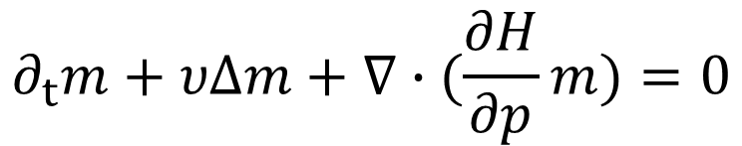

Numerically Modeling Mean Field Games
$$∂_{t}u−υΔu+H(x,∇u)=W(m)$$
Mean Field Games
$$u(x,T)=C(x)$$
$$∂_{t}m+υΔm+∇∙(\frac{∂H}{∂p}m)=0$$
$$m(x,0)=m_{0}(x)$$
Solve the value PDE backward in time and solve the density equation forward in time

Slide 28
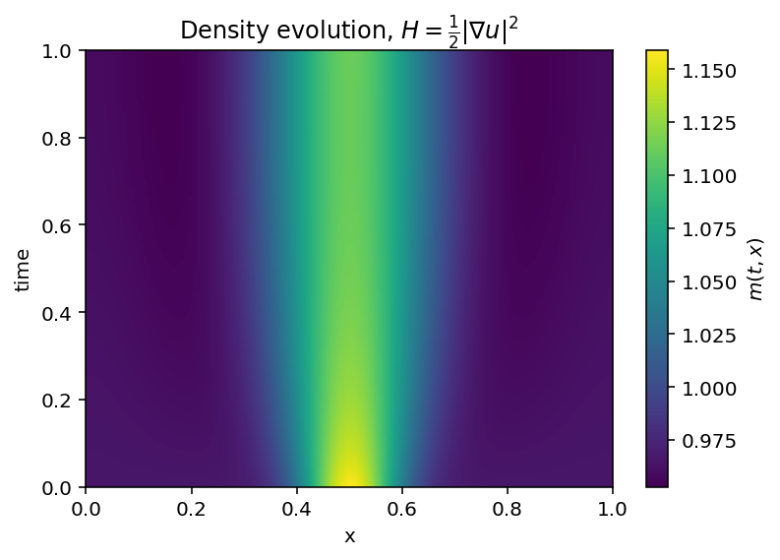
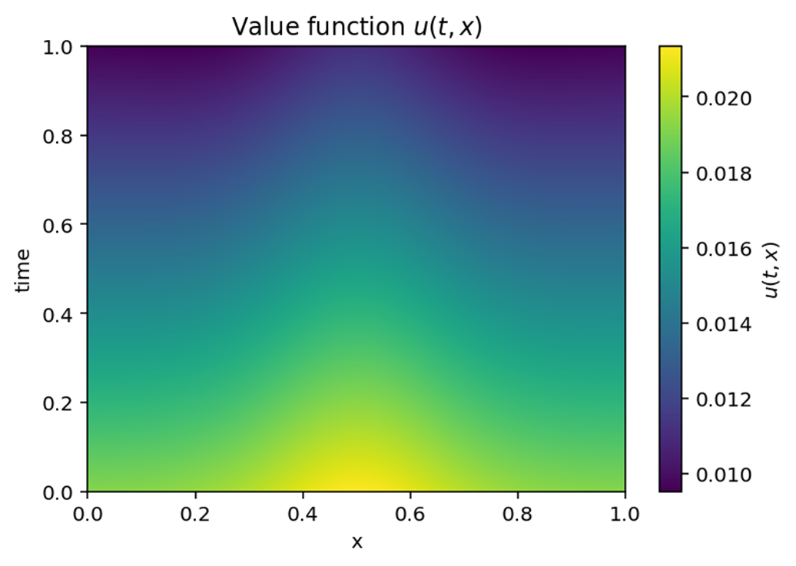


Numerically Modeling Mean Field Games
$$ρ\left(0,x\right)=1+\frac{1}{5}e^{−100{(x − \frac{1}{2})}^{2}}$$
$$u\left(T,x\right)=.1ρ\left(T,x\right)$$

Slide 29
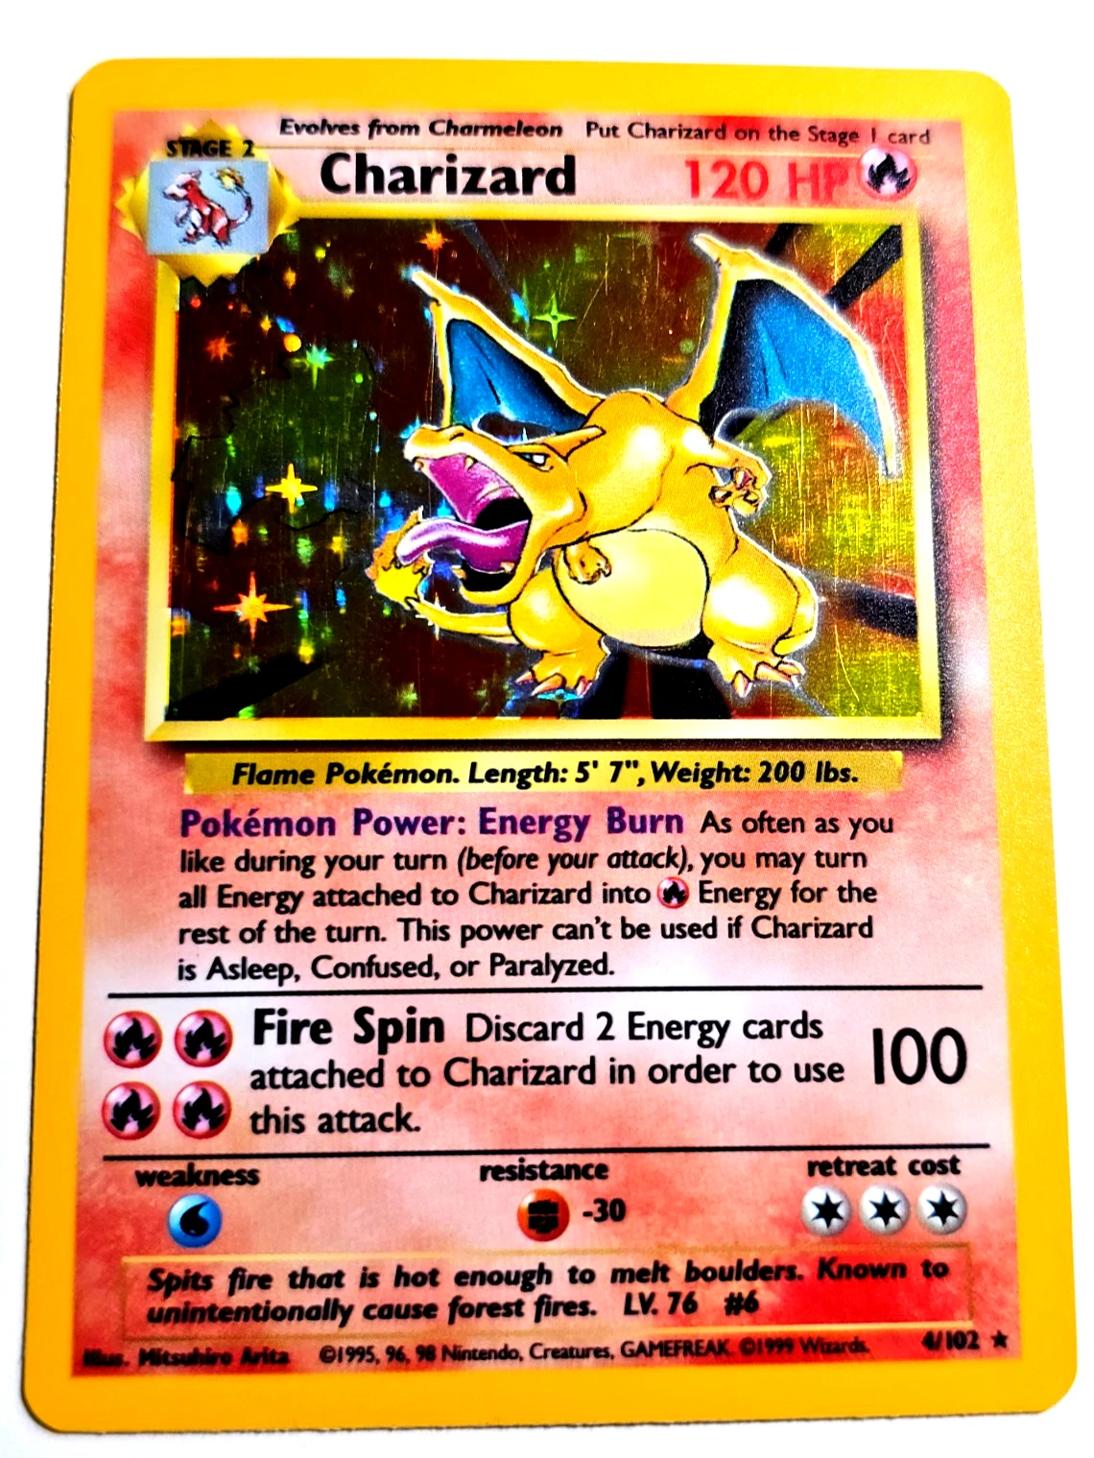
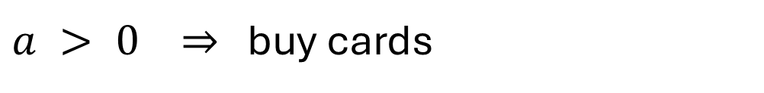


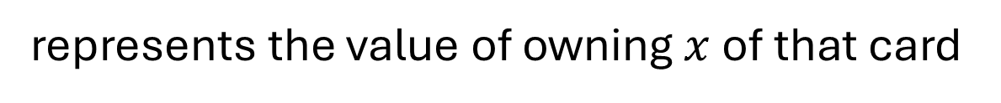
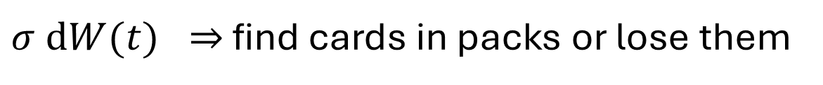

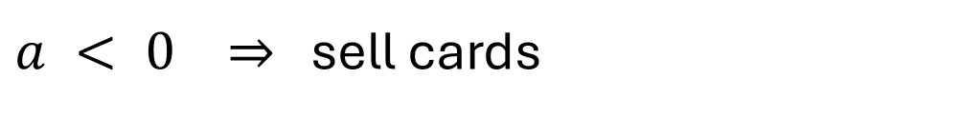
“Financial” Example
Suppose a group of traders are collecting a specific type of Pokémon card
$$u(x,t)$$
represents the value of owning $x$ of that card
$$m(x,t)$$
represents the distribution of inventories
Stochastic Time Evolution:
$$dX(t)=a dt+σ dW(t)$$
$a > 0 ⇒$ buy cards
$a < 0 ⇒$ sell cards
$σ dW(t) ⇒$ find cards in packs or lose them

Slide 30

“Financial” Example
Assume that buying or selling cards has a quadratic cost. This can be thought of the result of buying or selling moving the price against you
Further assume that there is a running iteration term $W(m)$
The objective structure of our system is:
$J\left(x_{0},t_{0},a\right)=\int_{t_{0}}^{T}{( 1/2{\left|a(τ)\right|}^{2}+W(m) )dτ}$
The associated HJB equation is: $∂_{t}u−{1/2σ}^{2}Δu+1/2{\left|∇u\right|}^{2}=W(m)$
$$∂_{t}m+υΔm+∇∙(∇u m)=0$$

